Slide 1


International University
MICRO-PROCESSING SYSTEM
Lecture 10:
AVR SPI INTERFACE
Vo Minh Thanh, M.Eng
School Of Electrical Engineering

Slide 2
SPI BUS Protocol
The SPI (serial peripheral interface) is a bus interface connection incorporated into many devices such as ADC, DAC, and EEPROM.
The SPI bus was originally started by Motorola Corp. (now Freescale), but in recent years has become a widely used standard adapted by many semiconductor chip companies.
SPI devices use only 2 pins for data transfer, called SDI (Din) and SDO (Dout).
This reduction of data pins reduces the package size and power consumption, making them ideal for in which space is a major concern.
The SPI bus has the SCLK (shift clock) pin to synchronize the data transfer between two chips.
The last pin of the SPI bus is CE (chip enable), which is used to initiate and terminate the data transfer.

Slide 3
SPI BUS Protocol
These 4 pins, SDI, SDO, SCLK, and CE, make the SPI a 4-wire interface.
The SDI, SDO, SCLK, and CE signals are alternatively named as MOSI, MISO, SCK, and SS.

Slide 4
SPI BUS Protocol
There is also a widely used standard called a 3-wire interface bus. In a 3-wire interface bus, we have SCLK and CE, and only a single pin for data transfer.
The SPI 4-wire bus can become a 3-wire interface when the SDI and SDO data pins are tied together.
But there are some major differences between the SPI and 3-wire devices in the data transfer protocol.
For that reason, a device must support the 3-wire protocol internally in order to be used as a 3-wire device.
Many devices such as the DS1306 RTC (real-time clock) support both SPI and 3-wire protocols.

Slide 5
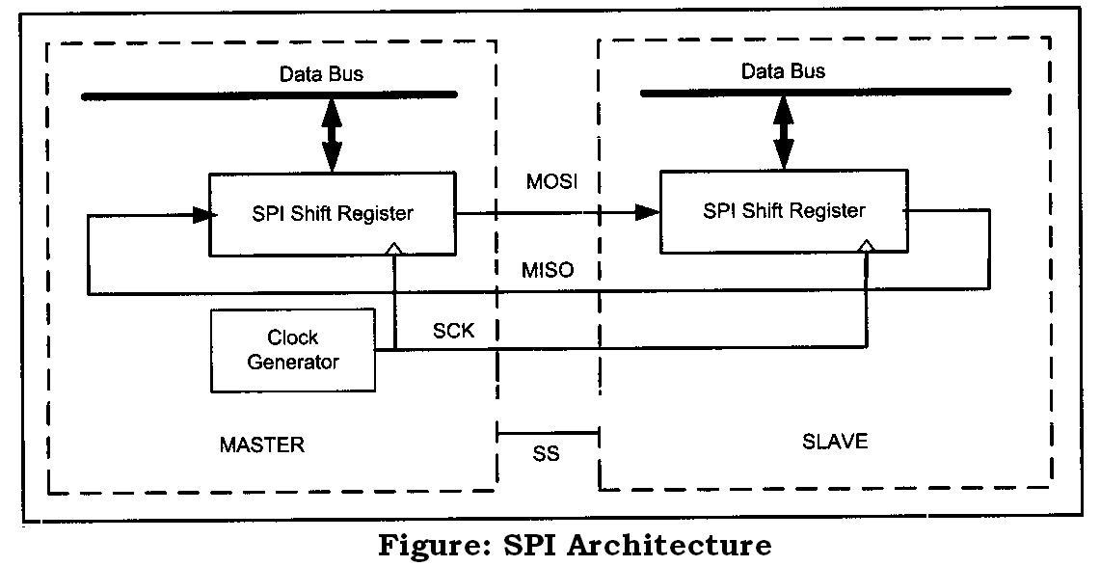
HOW SPI WORKS?
SPI consists of two shift registers, one in the master and the other in the slave side. Also, there is a clock generator in the master side that generates the clock for the shift registers.

Slide 6
HOW SPI WORKS?
The serial-out pin of the master shift register is connected to the serial-in pin of the slave shift register by MOSI (Master Out Slave In).
The serial-in pin of the master shift register is connected to the serial-out pin of the slave shift register by MISO (Master In Slave Out).
The master clock generator provides clock to the shift registers in both the master and slave.
The clock input of the shift registers can be falling- or rising-edge triggered.
Shift registers are 8 bits long. So after 8 clock pulses, the contents of the two shift registers are interchanged.
When the master wants to send a byte of data, it places the byte in its shift register and generates 8 clock pulses.

Slide 7
HOW SPI WORKS?
After 8 clock pulses the byte is transmitted to the other shift register.
When the master wants to receive a byte of data, the slave side should place the byte in its shift register, and after 8 clock pulses the data will be received by the master shift register.
It must be noted that SPI is full duplex, meaning that it sends and receives data at the same time.

Slide 8
SPI read and write
We use the microcontroller as the master while the SPI device acts as a slave. So the µc generates the SCLK, which is fed to the SCLK pin of the SPI device.
The SPI protocol uses SCLK to synchronize the transfer of information one bit at a time, where the most-significant bit (MSB) goes in first.
During the transfer, the CE must stay HIGH.
The information (address and data) is transferr-ed between the microcontroller and the SPI device in groups of 8 bits, where the address byte is followed immediately by the data byte.
To distinguish between the read and write operations, the D7 bit of the address byte is always 1 for write, while for the read, the D7 bit is LOW.

Slide 9
Clock Polarity and Phase in SPI device
In SPI communication, the master and slave(s) must agree on the clock polarity and phase with respect to the data.
Freescale names these two options as CPOL (clock polarity) and CPHA (clock phase), respectively, and most companies like Atmel have adopted that convention.
At CPOL = 0 the base value of the clock is zero, while at CPOL = 1 the base value of the clock is one. CPHA = 0 means sample on the leading (first) clock edge, while CPHA = 1 means sample on the trailing (second) clock.
If the base value of the clock is zero, the leading (first) clock edge, is the rising edge but if the base value of the clock is one, the leading (first) clock edge is falling edge.

Slide 10
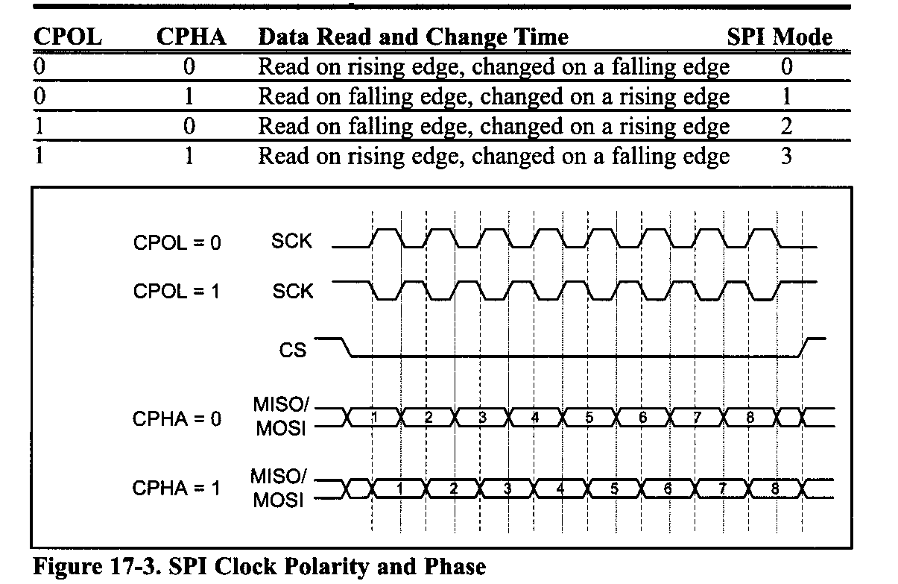
Clock Polarity and Phase in SPI device
The base value of clock is Zero
The base value of clock is One
Sample on First Clock Edge
Sample on Second Clock Edge

Slide 11
Steps for writing data to an SPI device
In accessing SPI devices, we have two modes of operation: single-byte and multibyte.
Single-byte write:
Make CE = 0 to begin writing.
The 8-bit address is shifted in, one bit at a time, with each edge of SCLK. Notice that A7 = 1 for the write operation, and the A7 bit goes in first.

Slide 12
Steps for writing data to an SPI device
After all 8 bits of the address are sent in, the SPI device expects to receive the data belonging to that address location immediately.
The 8-bit data is shifted in one bit at a time, with each edge of the SCLK.
Make CE = 1 to indicate the end of the write cycle

Slide 13
Steps for writing data to an SPI device
Multi-byte burst write:
In burst mode, we provide the address of the first location, followed by the data for that location. From then on, while CE = 0, consecutive bytes are written to consecutive memory locations.
In this mode, the SPI device internally increments the address location as long as CE is LOW.
The following steps are used to send (write) multiple bytes of data in burst mode for SPI devices as shown in Figure 17-5:
Make CE = 0 to begin writing.
The 8-bit address of the first location is provided and shifted in, one bit at a time, with each edge of SCLK. Notice that A7 = 1 for the write operation and the A7 bit goes in first.

Slide 14
Steps for writing data to an SPI device
The 8-bit data for the first location is provided and shifted in, one bit at a time, with each edge of the SCLK.
From then on, we simply provide con secutive bytes of data to be placed in consecutive memory locations. In the process, CE must stay low to indicate that this is a burst mode multibyte write operation.
Make CE = 1 to end writing.

Slide 15
Steps for reading data from an SPI device
Single-byte read
Make CE = 0 to begin reading.
The 8-bit address is shifted in one bit at a time, with each edge of SCLK. Notice that A7 = 0 for the read operation, and the A7 bit goes in first.
After all 8 bits of the address are sent in, the SPI device sends out data belonging to that location.
The 8-bit data is shifted out one bit at a time, with each edge of the SCLK.
Make CE = 1 to indicate the end of the read cycle

Slide 16
Steps for reading data from an SPI device
The 8-bit data is shifted out one bit at a time, with each edge of the SCLK.
Make CE = 1 to indicate the end of the read cycle.
Multi-byte burst read
In burst mode, we provide the address of the first location only. From then on, while CE = 0, consecutive bytes are brought out from consecutive memory locations.
In this mode, the SPI device internally increments the address location as long as CE is LOW.
The following steps are used to get (read) multiple bytes of data in burst mode for SPI devices

Slide 17
Steps for reading data from an SPI device
Make CE = 0 to begin reading.
The 8-bit address of the first location is provided and shifted in, one bit at a time, with each edge of SCLK. Notice that A7 = 0 for the read operation, and the A7 bit goes in first.
The 8-bit data for the first location is shifted out, one bit at a time, with each edge of the SCLK. From then on, we simply keep getting consecutive bytes of data belonging to consecutive memory locations. In the process, CE must stay LOW to indicate that this is a burst mode multibyte read operation.
Make CE = 1 to end reading.

Slide 18
Steps for reading data from an SPI device
consecutive bytes of data belonging to consecutive memory locations. In the process, CE must stay LOW to indicate that this is a burst mode multibyte read operation.
Make CE = 1 to end reading.

Slide 19
SPI Programming in AVR
In AVR three registers are associated with SPI. They are SPSR (SPI Status Register), SPCR (SPI Control Register), and SPDR (SPI Data Register)

Slide 20
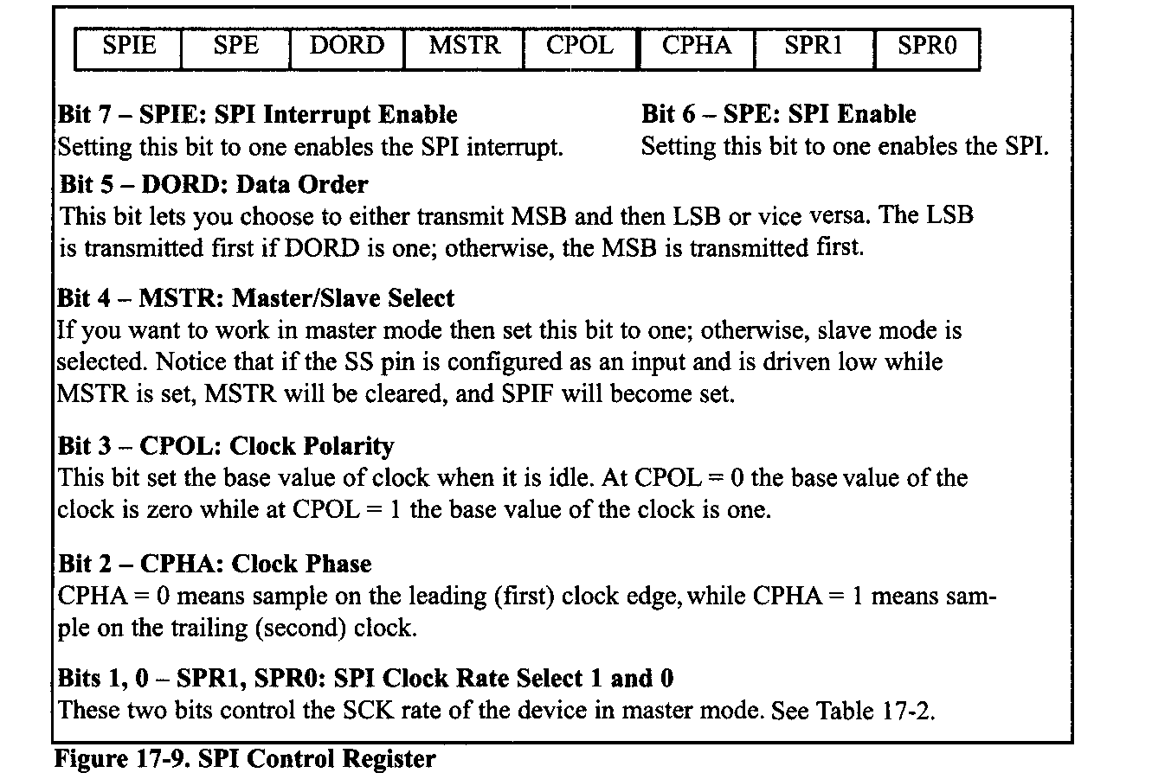
SPI Programming in AVR

Slide 21
SPI Programming in AVR
In Table 17-2 you see how SPI2X, SPR1, and SPRO are combined to make different clock frequencies for master. As you see in Table 17-2, by setting SPI2X to one, the SCK frequency is doubled.

Slide 22
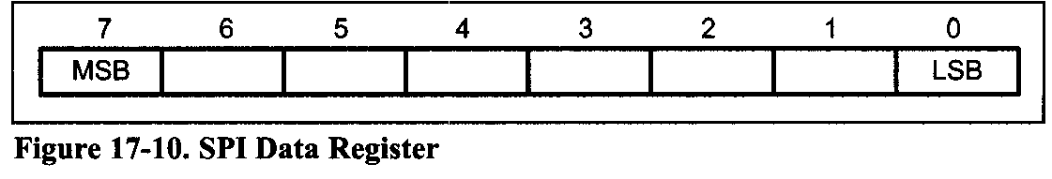
SPI Programming in AVR
SPDR (The SPI Data Register)
The SPI Data Register is a read/write register. To write into SPI shift register, data must be written to SPDR. To read from the SPI shift register, you should read from SPDR. Writing to the SPDR register initiates data transmission.
Notice that you cannot write to SPDR before the last byte is transmitted completely, otherwise a collision will happen. You can read the received data before another byte of data is received completely.

Slide 23
SPI Programming in AVR
SS pin in AVR
The Slave Select (SS) pin of the SPI bus is used to initiate and terminate the data transfer. In AVR, there are some points regarding this pin that you should pay attention to.
When you are in master mode, you can choose to make this pin either input or output. If you make it output, the SPI circuit of AVR will not control the SS pin and you can make it one or zero by software.
When you make the SS pin an input, it will control the function of SPI. In this case you should externally make SS pin high to ensure master SPI operation.
If an external device makes the SS pin low, the SPI module stops working in master mode and
switches to slave mode by clearing the MSTR bit

Slide 24
SPI Programming in AVR
in SPCR, and then sets the SPIF bit in SPSR.
It is highly recommended to make the SS pin output if you do not want to be interrupted when you are working in master mode.
When you are in slave mode, the SS pin is always input and you cannot control it by software. You should hold it externally low to activate the SPI. When SS is driven high, SPI is disabled and all pins of SPI are input. Also the SPI module will immediately clear any partially received data in the shift register. It can be used in packet synchronizing by initiating and terminating the data transfer.
When you are working in slave mode and the SS pin is driven high by an external device, the SPI module is reset but not disabled and it is not necessary to enable it again.

Slide 25
SPI Programming in AVR using C
Before you start data transmission, you should set SPI Mode (Clock Polarity and Clock Phase) by setting the values of the CPOL and CPHA bits in SPCR.
You can operate in either master or slave modes.
Master operating mode
If you want to work in master mode, you should set the MSTR bit to one. Also you should set SCK frequency by setting the values of SPI2X, SPR1, and SPR2.
Then you should enable SPI by setting the SPIE bit to one before you start data transmission.
Writing a byte to the SPI Data Register (SPDR) starts data exchange by starting the SPI clock generator.
After shifting the last (8th) bit, the SPI clock generator stops and the SPIF flag changes to one.

Slide 26
SPI Programming in AVR using C
The byte in the master shift register and the byte in the slave shift register are exchanged after the last clock.
Notice that you cannot write to the SPI Data Register before transmission is completed, otherwise the collision happens.
To get the received data you should read it from SPDR before the next byte arrives.
We can use interrupts or poll the SPIF to know when a byte is exchanged.
As we mentioned before, in case of multibyte burst write, the master continues to shift the next byte by writing it into SPDR.
If you want to signal the end of the packet, you should pull high the SS pin.

Slide 27
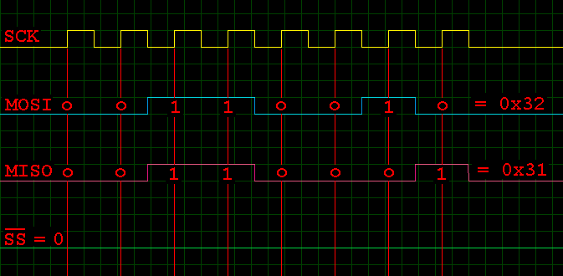
SPI Programming in AVR
First Clock Edge
LSB goes at end

Slide 28
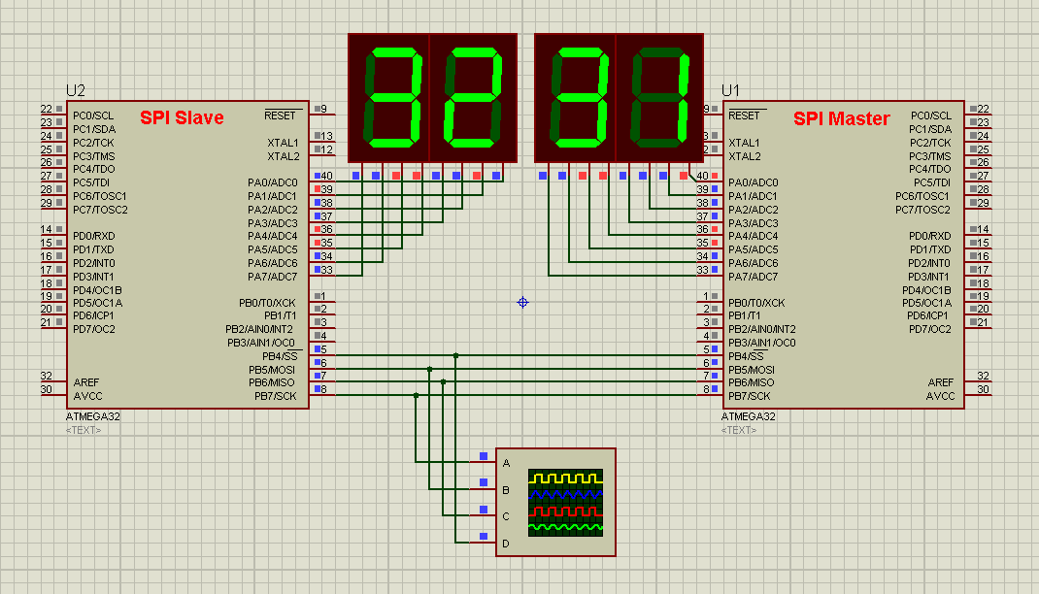

Slide 29
Write an AVR program to initialize the SPI for master, mode 0, with CLCK frequency = Fosc/16, and then transmit 0 to 255 via SPI repeatedly. The received data should be displayed on Port A and send back the received no.
//////////////// SPI MASTER TRANSMITTER PROGRAM PAGE 1/2 ////////////////
# define F_CPU 1000000UL // define crystal frequency for delay.h
#include <avr/io.h> // standard AVR header
#include <util/delay.h>
#define SS 4 // Slave Select is Bit No.4
#define MOSI 5 // Master Out Slave In is Bit No.5
#define MISO 6 // Master In Slave Out is Bit No.6
#define SCK 7 // Shift Clock is Bit No.7
void SPI_MasterInit(void){
// Set MOSI, SCK and SS as Output Pins
DDRB |= (1<<MOSI) | (1<<SCK) | (1<<SS) ;
DDRB &= ~(1<<MISO); // Set MISO as an Input Pin
// Enable SPI, Master mode, Shift Clock = CLK /16
SPCR = (1<<SPE)|(1<<MSTR)|(1<<SPR0);
PORTB &= ~(1<<SS); // Enable Slave Select Pin
}

Slide 30
Write an AVR program to initialize the SPI for master, mode 0, with CLCK frequency = Fosc/16, and then transmit 0 to 255 via SPI repeatedly. The received data should be displayed on Port A and send back the received no.
///////////////// SPI MASTER TRANSMITTER PROGRAM PAGE 2/2 ////////////////
unsigned char SPI_MasterTransmit(unsigned char cData){
SPDR = cData; // Start transmission
while(!(SPSR & (1<<SPIF))); // Wait for transmission complete
return SPDR; // return the received data
}
int main(){
unsigned char ch = 0; // data to send
DDRA = 0xFF; // PORTA is Output Port
SPI_MasterInit(); // Run as SPI Master
for(ch=0 ; ch<=255 ; ch++){ // infinite for loop for 0 to 255
_delay_ms(1000); // Call One Sec delay
// send and receive data and show received at PORTA
PORTA = SPI_MasterTransmit(ch);
}
return 0;
}

Slide 31
SPI Programming in AVR
When AVR is configured as a master, the SPI will not control the SS pin. If you want to make SS high or low, you have to do it by writing 1 or 0, respectively, to the SS bit of Port B. Slave operating mode
Slave Operating Mode
When AVR is configured as a slave, the function of the SPI interface depends on the SS pin. If the SS is driven high, MISO is tri-stated and the SPI interface sleeps. Only the contents of SPDR may be updated in this state.
When SS is driven low, the data will be shifted by incoming clock pulses on the SCK pin.
SPIF changes to one when the last bit of a byte has been shifted completely. Notice that the slave can place new data to be sent into SPDR before reading the incoming data; this is because in AVR there are two one-byte buffers to store received data.

Slide 32
SPI Programming in AVR
Slave Operating Mode
In slave mode there is no need to set SCK frequency because the SCK is generated by the master.
But you must select the SPI mode (Clock Phase and Clock Polarity) and Data Order to match with SPI mode and Data Order of the other side (master device).
Finally you should enable the SPI by setting the SPIE bit of SPCR to one. See Next Example which is the slave version of Previous Example.

Slide 33
Write an AVR program to initialize the SPI for slave, mode 0, and Show the received data on Port A
////////////////////// SPI SLAVE PROGRAM PAGE 1/2 ///////////////////////
#define F_CPU 1000000UL // define crystal frequency for delay.h
#include <avr/io.h> // standard AVR header
#include <util/delay.h>
#define SS 4 // Slave Select is Bit No.4
#define MOSI 5 // Master Out Slave In is Bit No.5
#define MISO 6 // Master In Slave Out is Bit No.6
#define SCK 7 // Shift Clock is Bit No.7
void SPI_SlaveInit(void){
DDRB |= (1<<MISO); // Set MISO as an Output Pin
// Set MOSI, SCK and SS as Input Pins
DDRB &= ~(1<<MOSI) & ~(1<<SCK) & ~(1<<SS) ;
// Enable SPI as a Slave Device
SPCR = (1<<SPE);
}

Slide 34
Write an AVR program to initialize the SPI for slave, mode 0, and Show the received data on Port A
////////////////////// SPI SLAVE PROGRAM PAGE 2/2 ///////////////////////
unsigned char SPI_SlaveReceive(unsigned char cData){
SPDR = cData; // send cData to master
// Wait for reception complete
while(!(SPSR & (1<<SPIF)));
// Return received data
return SPDR;
}
int main(){
DDRA = 0xFF; // PortA is Output
SPI_SlaveInit(); // configure as SPI Slave
while(1)
// send value of PORTA to Master and
// Show Received data at PORTA
PORTA = SPI_SlaveReceive(PORTA);
return 0;
}

Slide 35
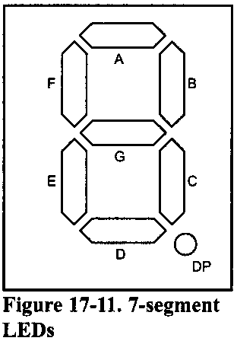
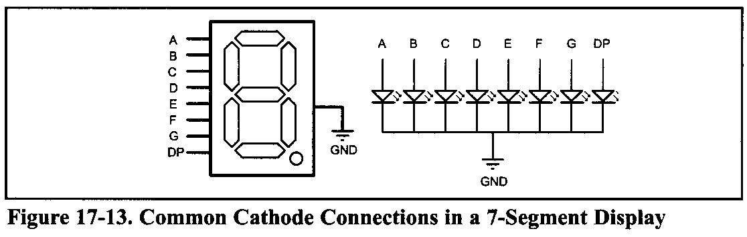
MAX7221 Interfacing and Prog…
7-Segment Display:
In many applications, when you want to display numbers, 7-segments are the best choice. These displays are made of 7 LEDs to show different numbers plus another LED to display the decimal point.

Slide 36
MAX7221 Interfacing and Prog…
If you want to connect four 7-segment LEDs directly to a microcontroller you need 4 x 8 = 32 pins. This is not feasible.
The MAX7221 IC is supports up to eight 7-segment LEDs. We can connect the MAX7221 to the AVR chip using SPI protocol and control up to eight 7-segment LEDs.
The MAX7221 contains an internal decoder that can be used to convert binary numbers to 7-segment codes. That means we do not need to refresh the 7-segment LEDs.
All you need to do is to send a binary number to the MAX7221, and the chip decodes the binary data and displays the number.
The device includes analog and digital brightness control, an 8x8 static RAM that stores each digit, and a test mode that forces all LEDs on.

Slide 37
MAX7221 Pins and Connections
The MAX7221 is a 24-pin DIP chip. It can be directly connected to the AVR and con-trol up to eight 7-segment LEDs. A resistor or a potentiometer is the only external component that you need. Next, we will discuss the pins of the MAX7221.
GND: Pin 4 and pin 9 are the ground. These should be connected to system ground
Vcc: Pin 19 is the VCC and should be connected to the +5V.this pin is also the power to drive the 7-segments and the connecting wire to this pin should be able to handle 100-300 mA.

Slide 38
MAX7221 Pins and Connections
ISET: Pin 18 is ISET and sets the maximum segment current. This pin should be connected to VCC through a resistor. A 10KΩ resistor can be connected to this pin. If you want to manually control the intensity of the segments' light, you can replace the resistor with a 50KΩ potentiometer.
CS :Pin 12 is the chip select pin and should be connected to the SS pin of the AVR. Serial data is loaded into the chip while CS is low, and the last 16 bits of the serial data are latched on CS's rising edge.

Slide 39
MAX7221 Pins and Connections
DIN: Pin 1 is the serial data input and should be connected to the MOSI pin of the AVR. On CLK's rising edge, data on this pin is loaded into the internal shift register. Notice that the MAX7221 uses the SPI Mode 0, that is, read on rising edge and change on falling edge..
CLK: Pin 13 is the serial clock input and should be connected to the SCK pin of the AVR. On MAX7221 the clock input is inactive when CS is high.
DOUT: Pin 24 is the serial data output and is used to connect more than one MAX7221 to a single SPI bus.

Slide 40
MAX7221 Pins and Connections
DIG0-DIG7:
The DIG pins are the 7-segment selector pins and should be connected to the 7-segments' common cathode pin. The MAX7221 chip can control up to eight 7-segment LEDs. These eight 7-segment dispalys are designated as DIGO to DIG7.
SEGA…SEGG and DP: These pins select each segment and should be connected to segments of each 7-segment accordingly.

Slide 41
MAX7221 data packet format
In MAX7221, data packets are 16 bits long (two bytes). You should first make CS low before transmitting; then you transmit two bytes of data and terminate the transmission by making CS high.
The first byte (MSBs) of each packet contains the command control bits, and the second byte is the data to be displayed.
The upper four bits (D15-D12) of the command byte are don't care and the lower four bits (D11-D8) are used to identify the meaning of the data byte to be followed.
The second byte (D7-D0) of the two-byte packet is called the data byte and is the actual data to be displayed or control the 7-segment driver.
Table 17-3 shows the binary and hex values of each command.

Slide 42
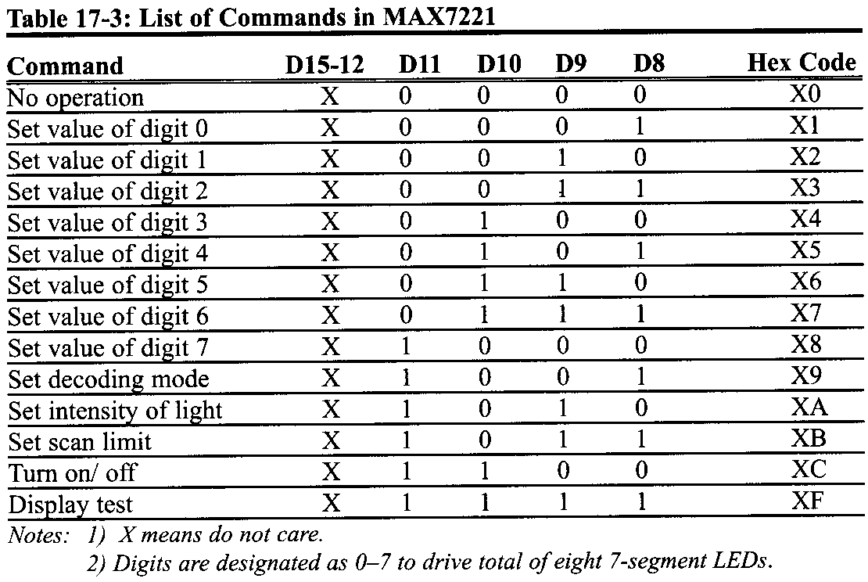
MAX7221 data packet format

Slide 43
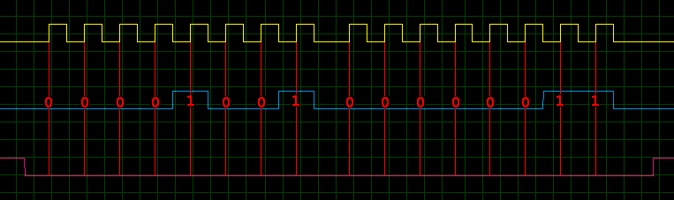
MAX7221 data packet format

Slide 44
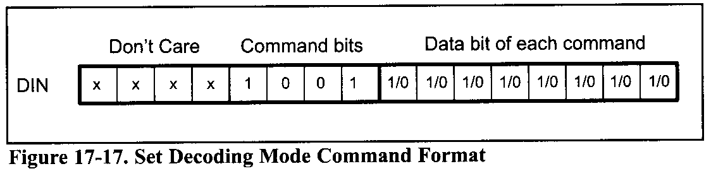
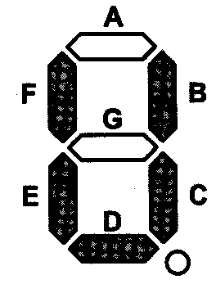

Slide 45
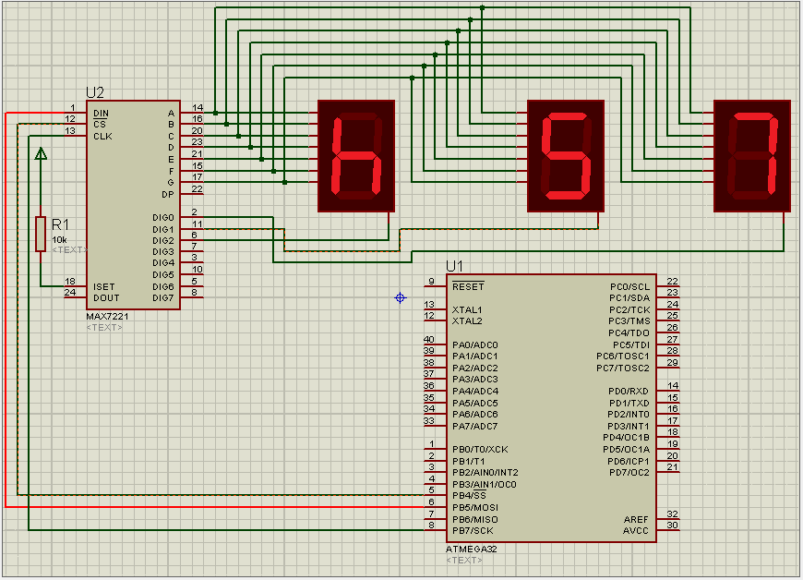

Slide 46
MAX7221 Interfacing and Prog…
#include <avr/io.h> //standard AVR header
#define SS 4
#define MOSI 5
#define SCK 7
void execute (unsigned char cmd, unsigned char data){
// initializing the packet by pulling SS low
PORTB &= ~(1<<SS) ;
SPDR = cmd; // start CMD transmission
// wait cmd transfer to finish
while (!(SPSR & (1<<SPIF) ) );
// start DATA transmission
SPDR = data;
// wait data transfer to finish
while (!(SPSR & (1<<SPIF) ) ) ;

Slide 47
MAX7221 Interfacing and Prog…
// terminate the packet by pulling SS high
PORTB |= 1<<SS;}
int main (void){
// MOSI, SCK and SS are output
DDRB = (1<<MOSI) | (1<<SCK) | (1<<SS) ;
// enable SPI as master, SCk = FOsc/16
SPCR = (1<<SPE) | (1<<MSTR)| (1<<SPR0);
execute(0x09,0x03); // decode only digit 0 and 1
execute(0x0B,0x02); // Set ScanLimit(upto digit 2)
execute(0x0A,0x0F); // max intensity
execute(0x0C,0x01); // Turn On Display
execute(0x01,0x07); // digit 0 is 7
execute(0x02,0x05); // digit 1 is 5
execute(0x03,0b00010111); // digit 2 is h
while(1); return 0;
}

Slide 48

MAX7221 Interfacing and Prog…
execute(0x09,0x03);

Slide 49
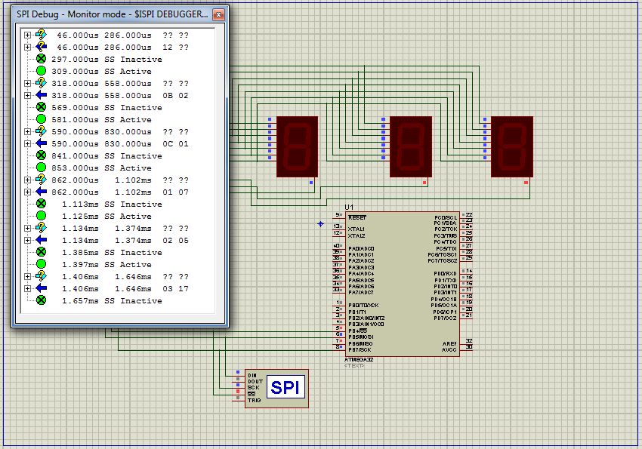

Slide 50
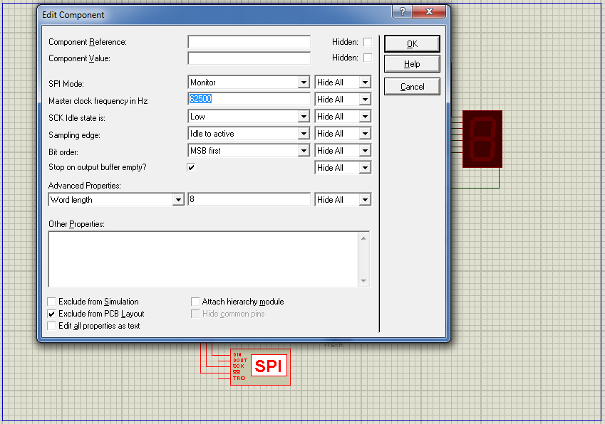

Slide 51
